Slide 1
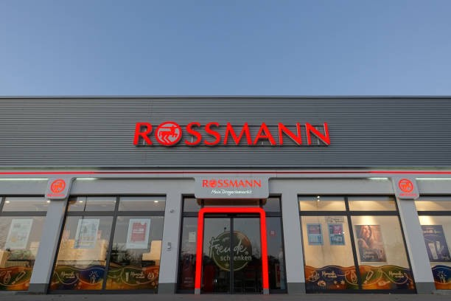
Capstone Project - 2 ROSSMANN SALES PREDICTION MACHINE LEARNING(REGRESSION) BY MD AMANATULLAH (Data Science Trainee) ALMABETTER

Slide 2
Table of Contents:- 1.Introduction 2.Variable Explanation 3.Import and Reading the Data 4.EDA on Datasets 5.Data cleaning and pre-processing ( Datetime Text and Expected Values Removing Rows and Columns Outliers(Sales and Customers) Missing values) 6.Merging of two datasets 7.Exploratory insights of the final datasets 8.Building Regression Model(Linear,DecisionTree,RandomForest) 9.Regression Model with Hyperparameter Tuning 10.Evaluation Metrics 11.Conclusion 12.Necessary suggestion
11

Slide 3
1. Business Problem. 1. Rossman operates over 3,000 drug stores in 7 European countries. 2. Currently, Rossman store managers are tasked with predicting their daily sales for up to six weeks in advance. 3.Store sales are influenced by many factors, including promotions, competition, school and state holidays, seasonality, and locality. 4.With thousands of individual managers predicting sales based on their unique circumstances, the accuracy of results can be quite varied.

Slide 4
Variable Explanation:-
Most of the fields are self-explanatory. The following are descriptions for those that aren’t.
Id - An Id that represents a (Store, Date) duple within the test.
Store - A unique Id for each store.
Sales - The turnover for any given day (this is what you are predicting).
Customers - The number of customers on a given day.
Open - An indicator for whether the store was open: 0 = closed, 1 = open.
State Holiday - Indicates a state holiday. Normally all stores, with few exceptions, are closed on state holidays.
Note that all schools are closed on public holidays and weekends.
a = public holiday, b = Easter holiday, c = Christmas, 0 = None.
School Holiday - Indicates if the (Store, Date) was affected by the closure of public schools.
Store Type - Differentiates between 4 different store models: a, b, c, d.
Assortment - Describes an assortment level: a = basic, b = extra, c = extended.
Competition Distance - Distance in meters to the nearest competitor store.
CompetitionOpenSince[Month/Year] - Gives the approximate year and month of the time the nearest
competitor was opened.
Promo - Indicates whether a store is running a promo on that day
Promo2 - Promo2 is a continuing and consecutive promotion for some stores:
0 = store is not participating, 1 = store is participating.
Promo2Since[Year/Week] - Describes the year and calendar week when the store started participating in Promo2
Promo Interval - Describes the consecutive intervals Promo2 is started, naming the months the promotion is started a new.
E.g., "Feb,May,Aug,Nov" means each round starts in February, May, August, November of any given year for that store

Slide 5
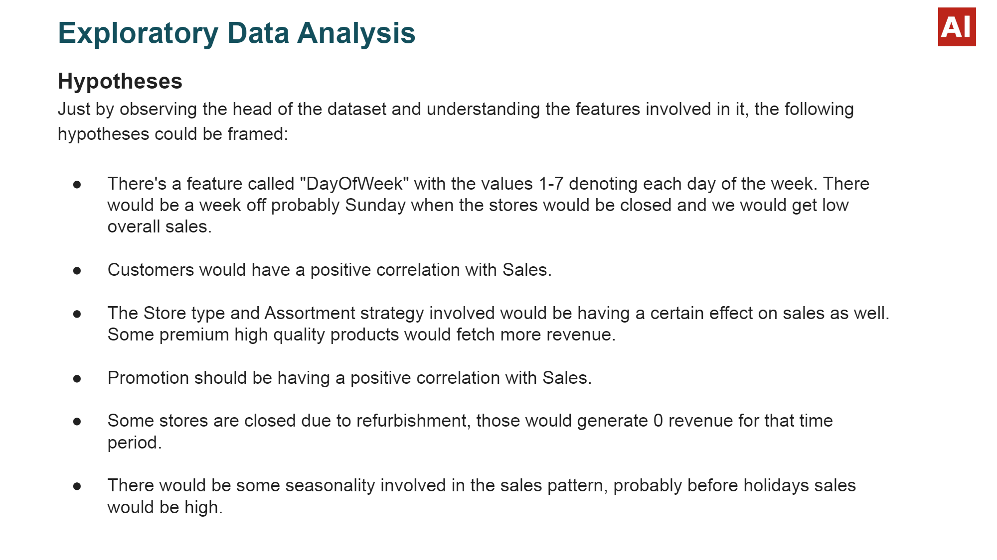

Slide 6
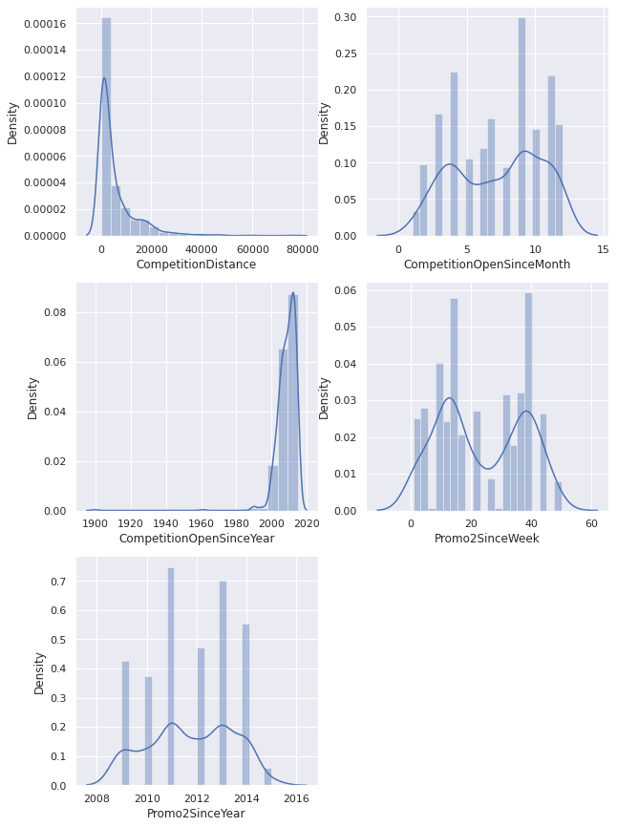
Treating Null Values:- First, we will check the distribution plot of those column which have null values if the distribution plot is normal then null values can be filled by mean if it is skewed the it will be filled by either median or mode. It can be clearly seen that Competition Distance and Competition Open Since Year columns are right and left skewed respectively hence the null values can be filled with median or mode. The other columns with missing values can be filled with 0.

Slide 7
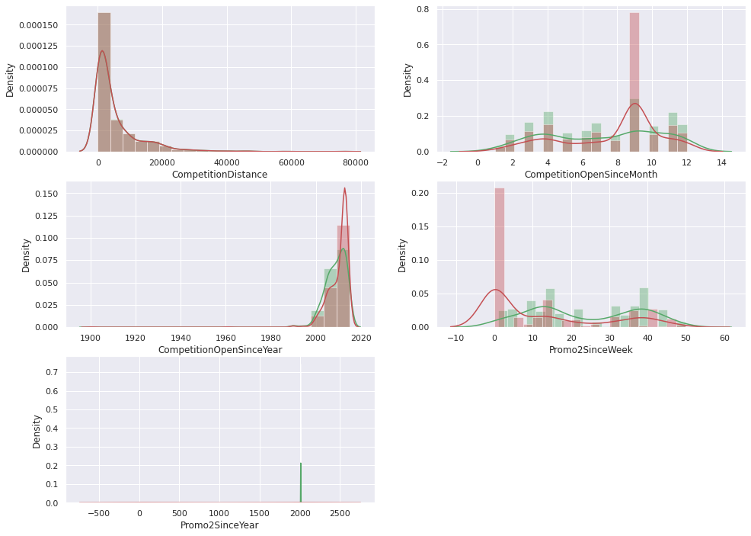
Checking the density plot of numeric features before and after filling the missing values.
With these density plot we can clearly
observe that after filling the missing
values there is no such difference in
the distribution plot from the original
data.
But still Competition Distance and
Competition Open Since Year are
respectively right and left skewed
indicating outliers which must be
treated.

Slide 8
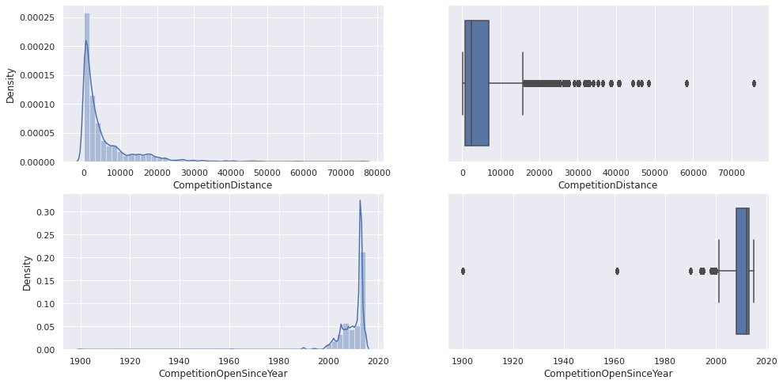
Outlier Detection Using density plot and box plot. These two features are right and left skewed, respectively.

Slide 9
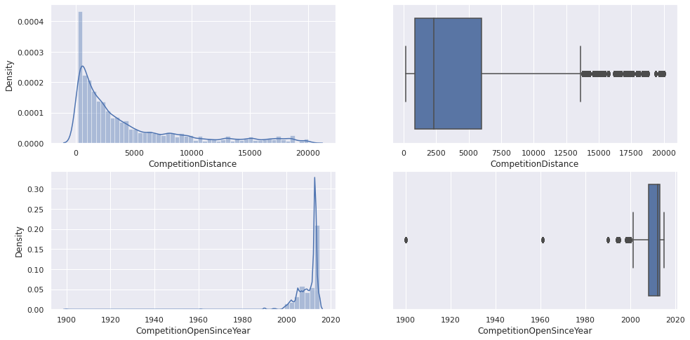
Outlier Removal using Percentile method. Removing outliers by percentile method. max_threshold=0.95 min_threshold=0.05

Slide 10
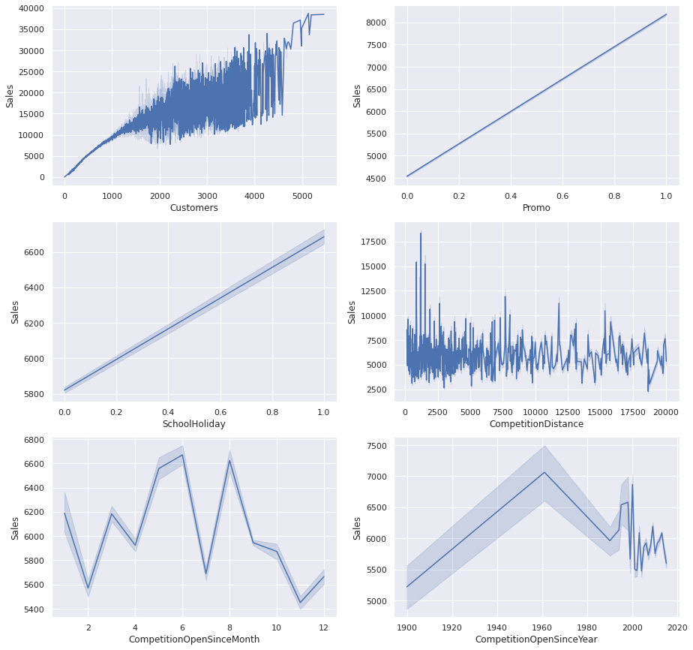
Checking the relation between the sales and other important features through line plot. 1.As the number of customers are increasing the sales are also increasing. 2.Promo has a positive effect on sales. 3.More sales recorded when there was school holiday. 4.Competition distance has complex relationship with sales but through the tale of the graph we can conclude that as the distance of competitor shop has increased the sales has also increased. 5.Competition open since month has complex relation with sales. 6.Competition open since year and sales have almost negative linear relationship. Older the competitor lesser the sales.

Slide 11
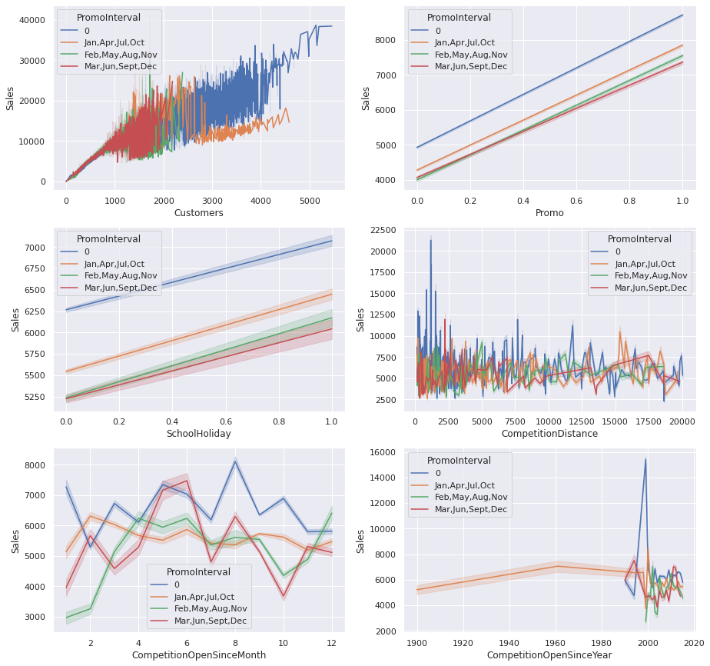
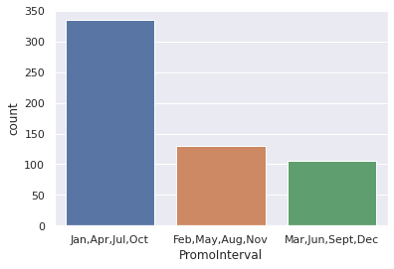
Checking the relation between the numeric features and sales for different promo interval. The most effective promo interval is Jan, Apr, Jul, Oct as it recorded more sales because it has more counts can be seen through count plot and the least effective is Mar, Jun, Sep, Dec. Surprisingly with no promo interval the sales are maximum. Because fifty percent of the data were missing and we filled it with 0 indicating no promo.

Slide 12
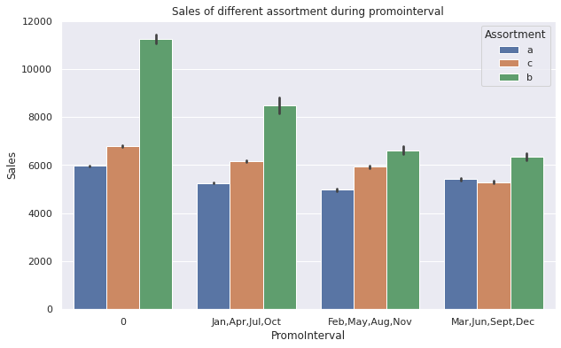
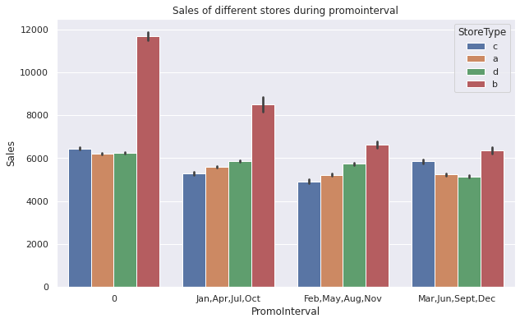
Sales of different store type and assortment during promo interval. During promo interval both assortment(a miscellaneous collection of things or people) b and store type b has large sells.

Slide 13
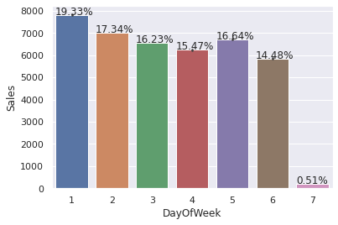
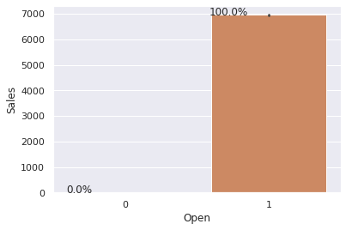
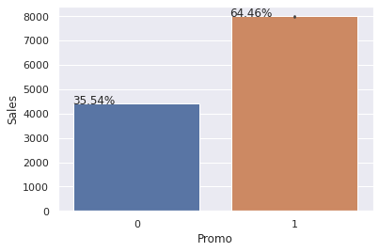
Bar plot of the sales Vs Important features. 1.More sells on Monday, less on Sunday, generally shops are closed on Sunday. 2.It could be seen that promo leads to more sells.

Slide 14
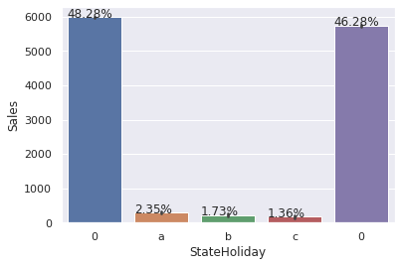
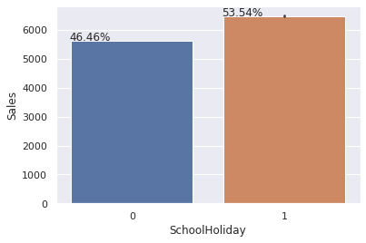
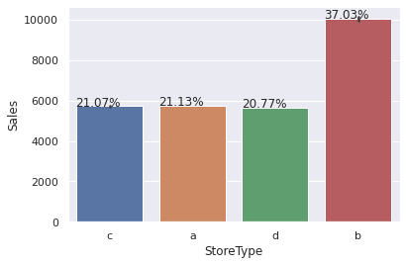
Bar Plot of the sales vs Important features:- 1.Normally all stores with few exception are closed on State Holiday a=Public Holiday, b=Easter, c=Christmas, 0=none. Lowest sales were observed on Christmas. More sells when there is no State Holiday. 2.Not much difference in sell either school is open or closed. 3.StoreType b has more sells among all indicating to open its more outlet.

Slide 15
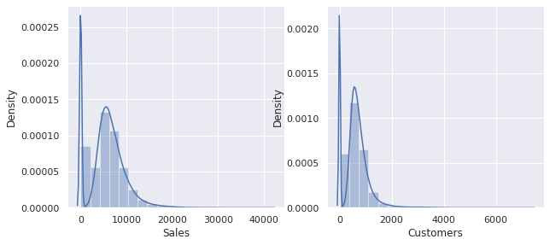
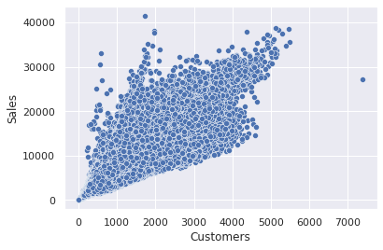
Sales Vs Customers:- 1.The distribution plot of Sales and Customers are somewhat rightly skewed, with increase in customers there is increase in sales. 2.Scatter Plot between Sales and Customers shows their linear relationship.

Slide 16
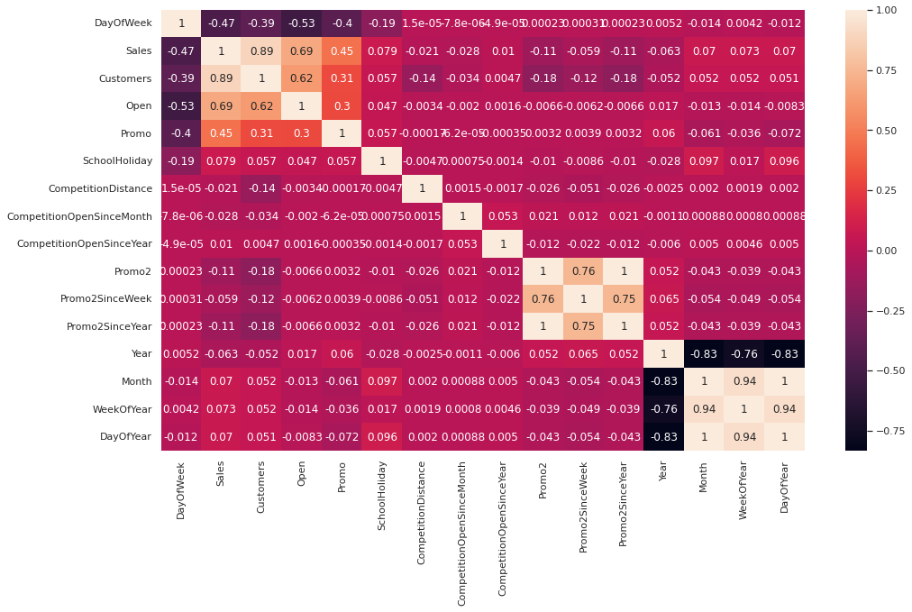
Checking Multicollinearity through Heatmap.

Slide 17
Observation and Conclusion drawn from Heatmap. Observations:- 1.Day of the week has a negative correlation indicating low sales as the weekends, and promo, customers and open has positive correlation. 2.State Holiday has a positive correlation indicating high sales. 3.CompetitionDistance showing negative correlation suggests that as the distance increases sales reduce, which was also observed through the scatterplot earlier. 4.There's multicollinearity involved in the dataset as well. The features telling the same story as Promo2, Promo2 since week and year are showing multicollinearity. 5.The correlation matrix is agreeing with all the observations done earlier while exploring through bar plots and scatterplots. Conclusion:- 6.Promo2 since week needs to be dropped as it shows multicollinearity with many features.

Slide 18
Machine Learning models implemented. 1.LinearRegression. 2.Regularized Linear Regression 3.Ridge and Lasso with hyperparameter tuning. 4.DecisionTree Regressor. 5.DecisionTree Regressor with hyperparameter tuning. 6.Random Forest Regressor. 7.Random Forest Regressor with hyperparameter tuning.

Slide 19
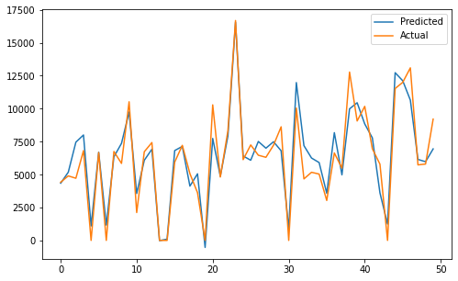
Evaluation metrics for Linear Regression.
Linear Regression score for training dataset: 0.900782955472085
Linear Regression score for testing dataset: 0.9008190832598643
Linear Regression r2_score for training dataset: 0.900782955472085
Linear Regression r2_score for testing dataset: 0.9008190832598643
Linear Regression mean squared error for training dataset: 1529344.495219654
Linear Regression mean squared error for testing dataset: 1539654.3394205498
Linear Regression RMSE for training dataset: 1236.666687195727
Linear Regression RMSE for testing dataset: 1240.828086166875
Linear Regression MAPE for training dataset: 4.330090282685447e+17
Linear Regression MAPE for testing dataset: 4.332721886071496e+17

Slide 20


Ridge Regression with and without hyperparameter tuning. Ridge Regression without hyperparameter tuning
Ridge Regression with hyperparameter tuning
Ridge Regression hyp score for training dataset: -1529344.499707297
Ridge Regression hyp score for testing dataset: -1539653.9219725737
Ridge Regression hyp r2_score for training dataset: 0.9007829551809468
Ridge Regression hyp r2_score for testing dataset: 0.9008191101508826
Ridge Regression hyp MSE for training dataset: 1529344.499707297
Ridge Regression hyp MSE for testing dataset: 1539653.9219725737
Ridge Regression hyp RMSE for training dataset: 1236.6666890101378
Ridge Regression hyp RMSE for testing dataset: 1240.8279179534018
Ridge Regression hyp MAPE for training dataset: 4.3300637559855994e+17
Ridge Regression hyp MAPE for testing dataset: 4.33270388726295e+17
Ridge Regression score for training dataset: 0.9007204843855741
Ridge Regression score for testing dataset: 0.9007660405046746
Ridge Regression r2_score for training dataset: 0.9007204843855741
Ridge Regression r2_score for testing dataset: 0.9007660405046746
Ridge Regression MSE for training dataset: 1530307.4327141184
Ridge Regression MSE for testing dataset: 1540477.7589944643
Ridge Regression RMSE for training dataset: 1237.0559537523427
Ridge Regression RMSE for testing dataset: 1241.159844256357
Ridge Regression MAPE for training dataset: 4.3155031433925344e+17
Ridge Regression MAPE for testing dataset: 4.321666013569699e+17

Slide 21
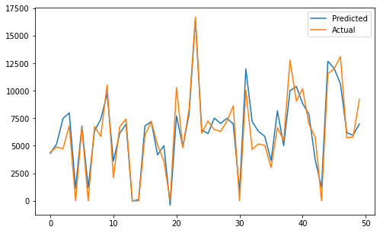
Lasso Regression with and without hyperparameter tuning. Lasso Regression without hyperparameter tuning Lasso Regression with hyperparameter tuning Lasso Regression score for training dataset: 0.9006218706072421 Lasso Regression score for testing dataset: 0.9006822823915992 Lasso Regression r2_score for training dataset: 0.9006218706072421 Lasso Regression r2_score for testing dataset: 0.9006822823915992 Lasso Regression MSE for training dataset: 1531827.4783853278 Lasso Regression MSE for testing dataset: 1541777.9944278186 Lasso Regression RMSE for training dataset: 1237.670181585275 Lasso Regression RMSE for testing dataset: 1241.6835323172402 Lasso Regression MAPE for training dataset: 4.2816697463994963e+17 Lasso Regression MAPE for testing dataset: 4.2818095885669523e+17
LassoRegression_hyp score for training dataset: -1529344.499707297 LassoRegression_hyp score for testing dataset: -1539653.9219725737
LassoRegression_hyp r2_score for training dataset: 0.9007829551809468 LassoRegression_hyp r2_score for testing dataset: 0.9008191101508826
LassoRegression_hyp MSE for training dataset: 1529344.499707297 LassoRegression_hyp MSE for testing dataset: 1539653.9219725737
LassoRegression_hyp RMSE for training dataset: 1236.6666890101378 LassoRegression_hyp RMSE for testing dataset: 1240.8279179534018
LassoRegression_hyp MAPE for training dataset: 4.3300637559855994e+17
LassoRegression_hyp MAPE for testing dataset: 4.33270388726295e+17

Slide 22
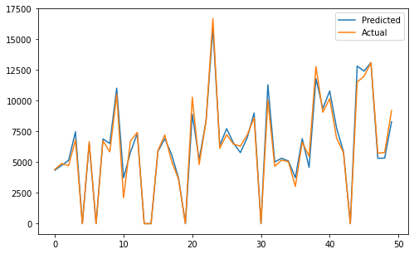

Decision Tree Regression with and without hyperparameter tuning. Decision Tree without hyperparameter tuning Decision Tree with hyperparameter tuning
Decision Tree hyp score for training dataset: 0.9824678722220436 Decision Tree hyp score for testing dataset: 0.9686351321760809
Decision Tree hyp r2_score for training dataset: 0.9824678722220436 Decision Tree hyp r2_score for testing dataset: 0.9686351321760809
Decision Tree hyp MSE for training dataset: 270242.5095837385 Decision Tree hyp MSE for testing dataset: 486898.6538708503
Decision Tree hyp RMSE for training dataset: 519.848544851035 Decision Tree hyp RMSE for testing dataset: 697.7812363992388
Decision Tree hyp MAPE for training dataset: 0.04427584762493161 Decision Tree hyp MAPE for testing dataset: 0.05872568123552392
Decision Tree score for training dataset: 0.9999997734901103
Decision Tree score for testing dataset: 0.9659955637948691
Decision Tree r2_score for training dataset: 0.9999997734901103
Decision Tree r2_score for testing dataset: 0.9659955637948691
Decision Tree MSE for training dataset: 3.4914530531339607
Decision Tree MSE for testing dataset: 527874.5093671068
Decision Tree RMSE for training dataset: 1.8685430295109504
Decision Tree RMSE for testing dataset: 726.5497294522288
Decision Tree MAPE for training dataset: 2.679722994967667e-06
Decision Tree MAPE for testing dataset: 0.062211701533658285

Slide 23

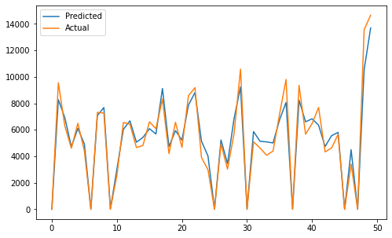
Random Forest Regression with and without hyperparameter tuning. Random Forest Regression without hyperparameter tuning Random Forest Regression with hyperparameter tuning
rf1_hyp score for training dataset: 0.9517740083594961
rf1_hyp score for testing dataset: 0.9400802438371919
rf1_hyp r2_score for training dataset: 0.9517740083594961
rf1_hyp r2_score for testing dataset: 0.9400802438371919
rf1_hyp MSE for training dataset: 740043.7107157686
rf1_hyp MSE for testing dataset: 909221.1444131008
rf1_hyp RMSE for training dataset: 860.2579326665744
rf1_hyp RMSE for testing dataset: 953.5308827788961
rf1_hyp MAPE for training dataset: 1.4229857605066734e+16
rf1_hyp MAPE for testing dataset: 1.6361307042570278e+16
rf score for training dataset: 0.9975569131712207
rf score for testing dataset: 0.98341721556677
rf r2_score for training dataset: 0.9975569131712207
rf r2_score for testing dataset: 0.98341721556677
rf MSE for training dataset: 37658.05976901414
rf MSE for testing dataset: 257426.09416682454
rf RMSE for training dataset: 194.05684674603506
rf RMSE for testing dataset: 507.37175144742196
rf MAPE for training dataset: 241807496879.79065
rf MAPE for testing dataset: 0.045049077571642976

Slide 24
Model Performance and Evaluation:- The dataset used in this analysis has:-
A multivariate time series relation with sales and hence a linear relationship cannot be assumed in this analysis. This kind of dataset has patterns such as peak days, festive seasons etc. which would most likely be considered as outliers in simple linear regression.
Having X columns with 30% continuous and 70% categorical features, businesses prefer the model to be interpretable in nature and decision-based algorithms work better with categorical data. Hence a simple decision tree was used as a baseline model.
The baseline model completely overfitted the data with a train R2 of 0.99999 and test R2 of 0.96599 .To prevent overfitting we built random forest model.
Random forest builds multiple decision trees and merges them together to get a more accurate and stable prediction.
Random Forest Regressor results were much better than our baseline model with a test R2 of 0.98341.
Tuning the hyperparameters gave the results with a test R2 of 0.94008.

Slide 25
Conclusion and Recommendations:-
Businesses use sales forecasts to determine what revenue they will be generating in a particular timespan to empower themselves with powerful and strategic business plans Important decisions such as budgets, hiring, incentives, goals, acquisitions and various other growth plans are affected by the revenue the company is going to make in the coming months and for these plans to be as effective as they are planned to be it is important for these forecasts to also be as good. Some important conclusions drawn from the analysis are as follows.
The positive effect of promotion on Customers and Sales.
Most stores have competition distance within the range of 0 to 10 kms and had more sales than stores far away probably indicating competition in busy locations vs remote locations.
Store type B though being few had the highest sales average. The reasons Include all three kinds of assortments specially assortment level b which is only available at type b stores and being open on Sundays as well.
The outliers in the dataset showed justifiable behavior. The outliers were either of store type b or had promotion going on which increased sales.
Recommendations:-
More stores should be encouraged for someone. Store type B should be increased in numbers. There's a seasonality involved hence the stores should be encouraged to promote and take advantage of the days.

